Slide 1

AN ONLINE PLATFORM FOR CONNECTING FARMERS WITH MEDICINE SHOP AND EXPERT

Slide 2
SCHEMA
Shop : (id , name , address , manager_id , contact_no , email_id)
Worker : (id , name , shop_id , joining_date , salary)
user : (id , user_name , address , identity)
Login : (id , password)
Register : (user_id , user_name , address , email_id , password)
Company : (id, name , address)
Expert : (id , name , expertise , email_id , company_id)
Medicine : (id, name , shop_id , company_id , availability , price)
Cattle : (disease , medicine_id , description)
poultry : (disease , medicine_id , description)
fish : (disease , medicine_id , description)
View : (user_id , shop_id , transactions , rating )

Slide 3
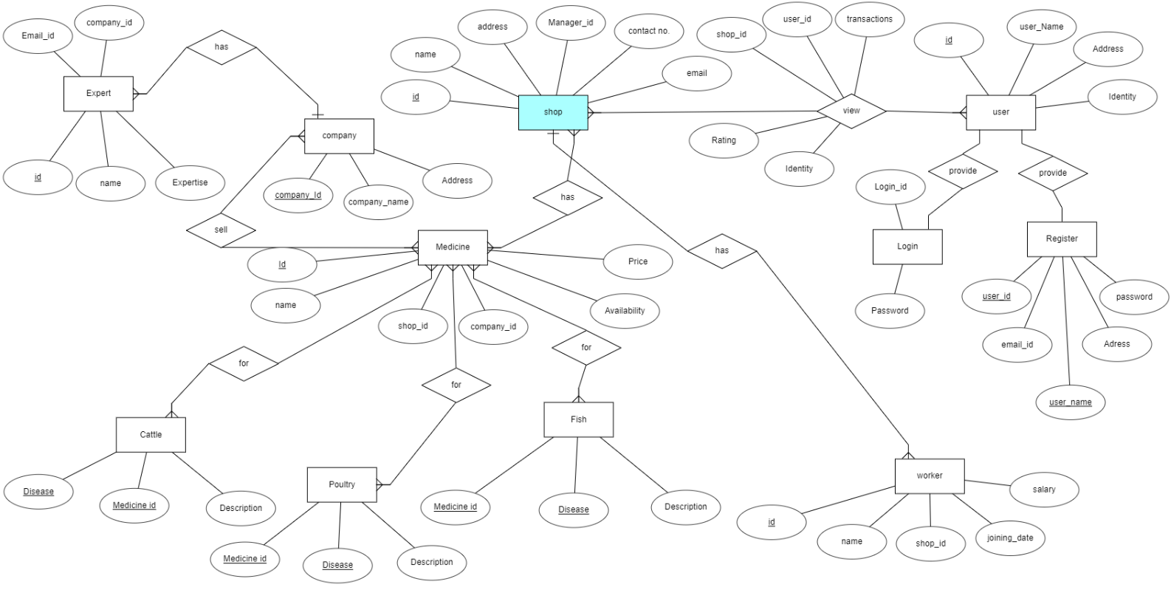
ERD DIAGRAM

